Slide 1
Cornerstone City Church Peninsula Plus Community Hoo Are Ya
4th February 2024

Slide 2


Slide 3


Slide 4
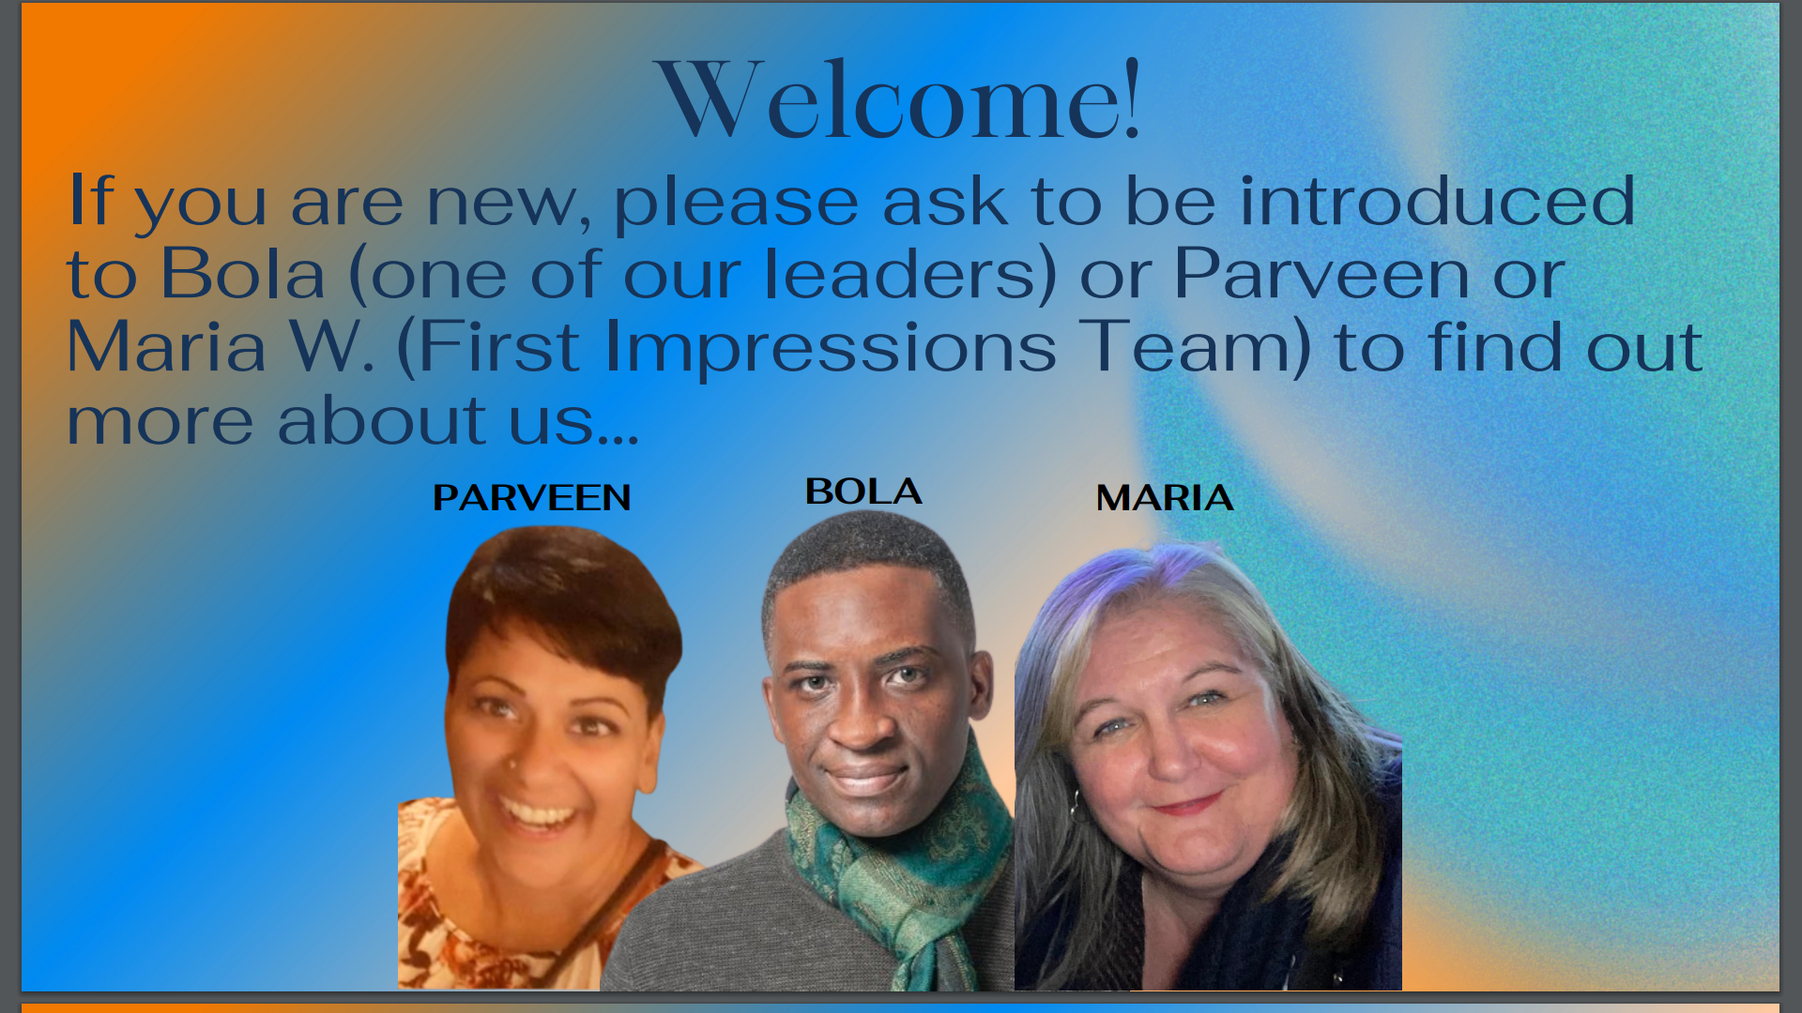

Slide 5
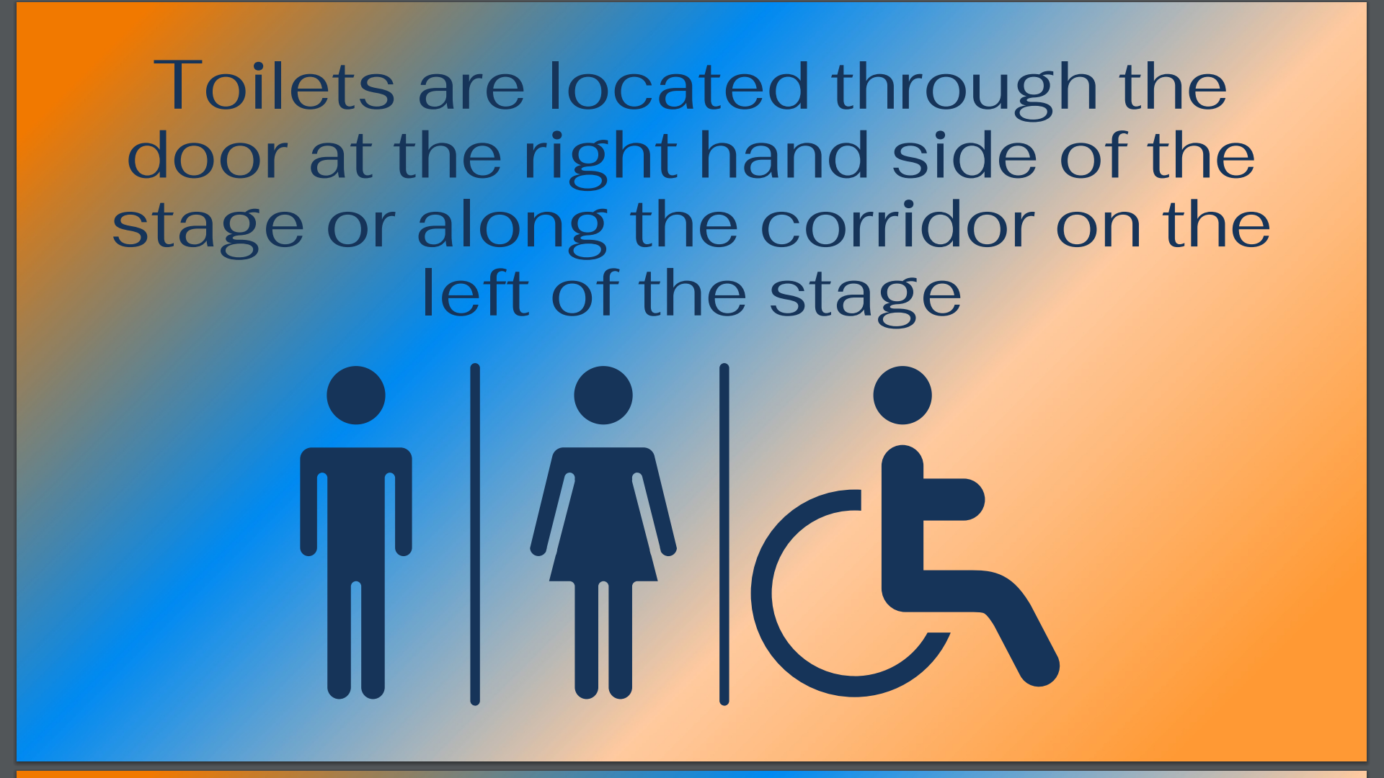

Slide 6
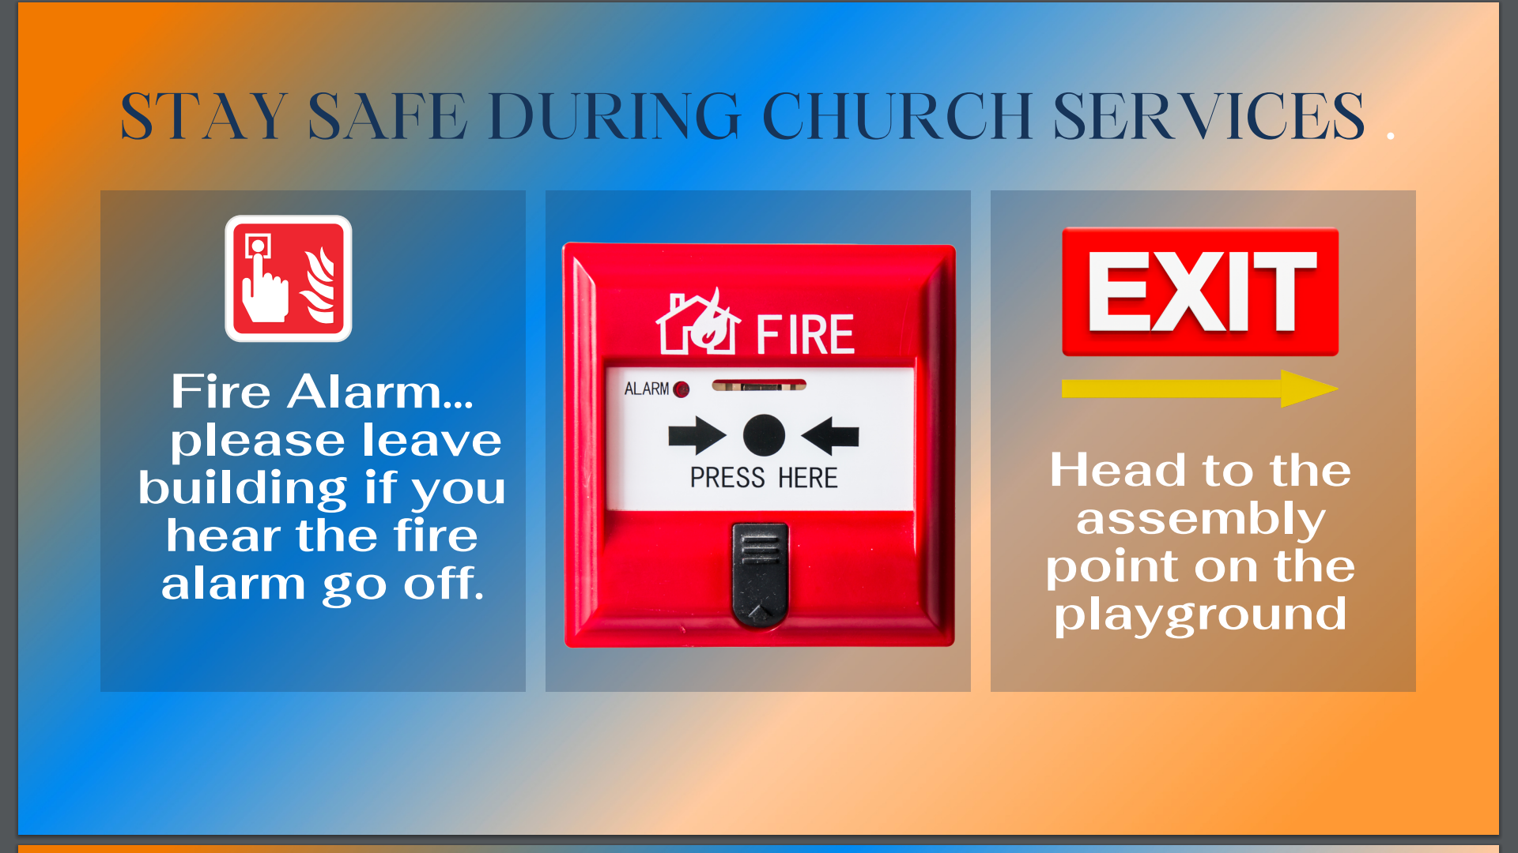

Slide 7
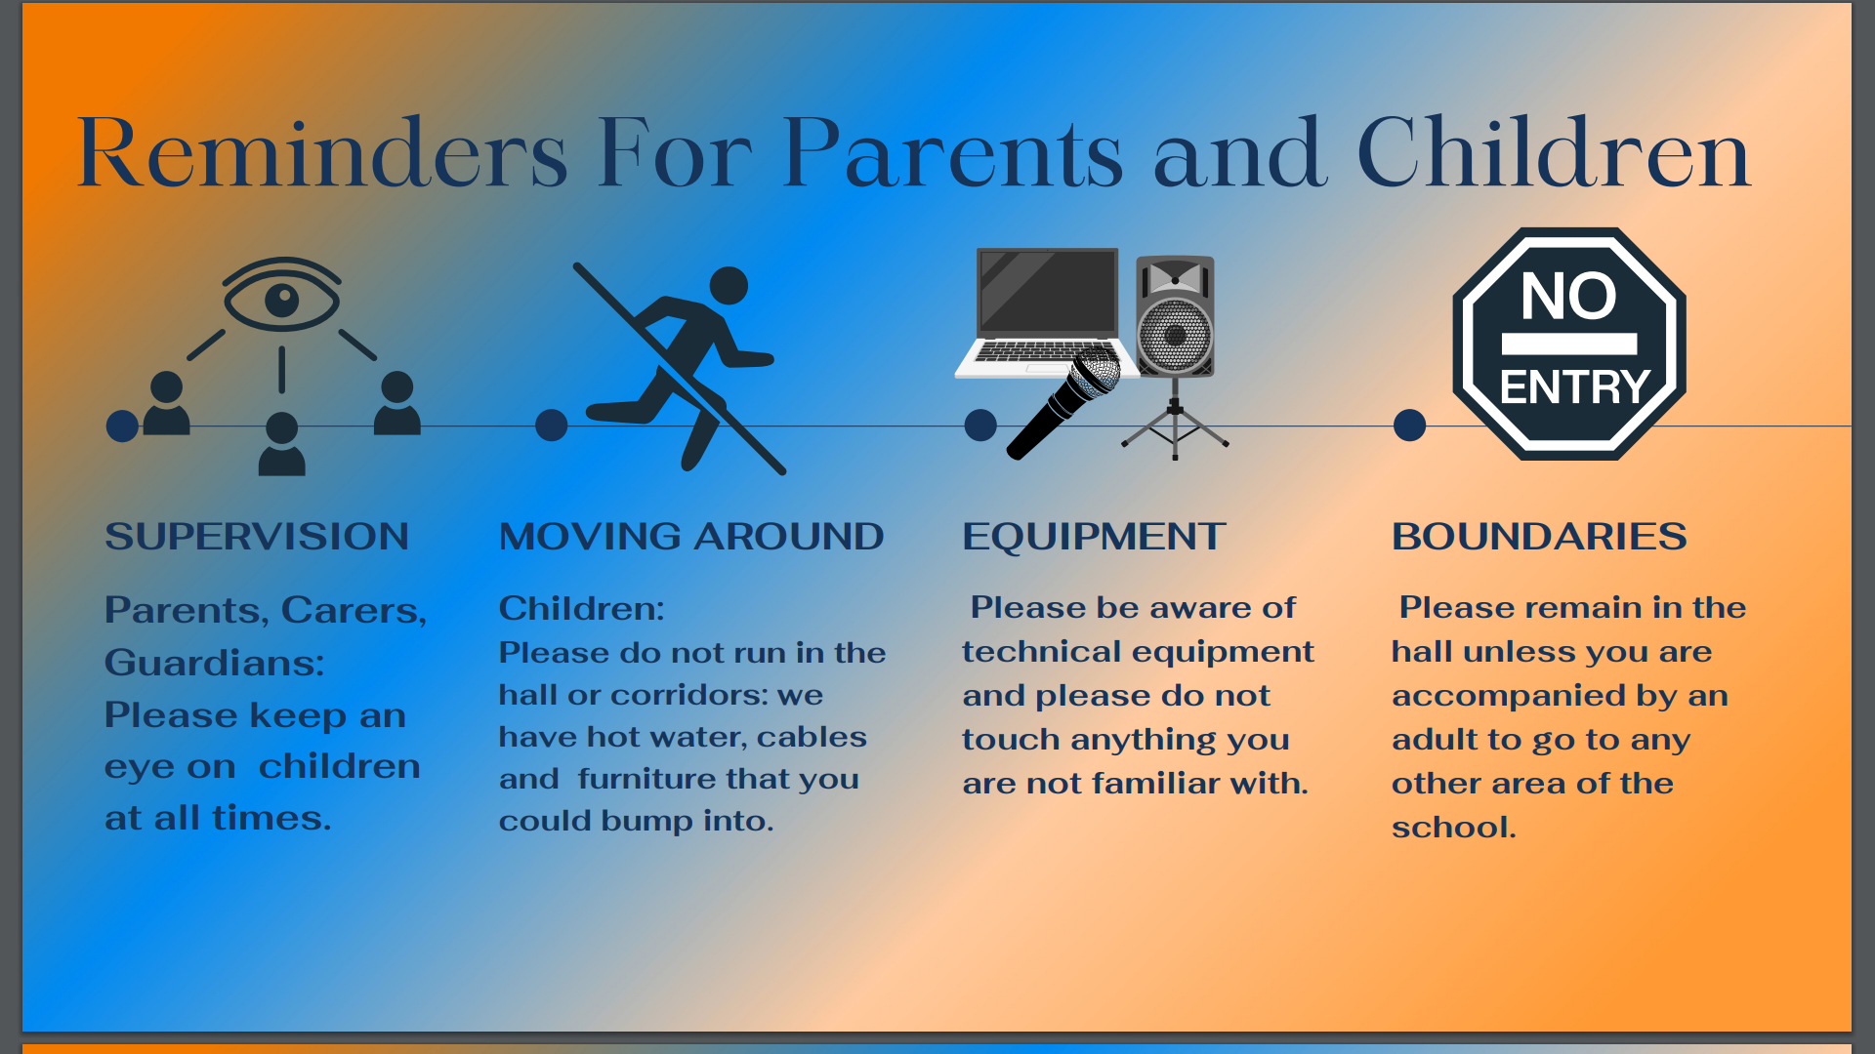

Slide 8
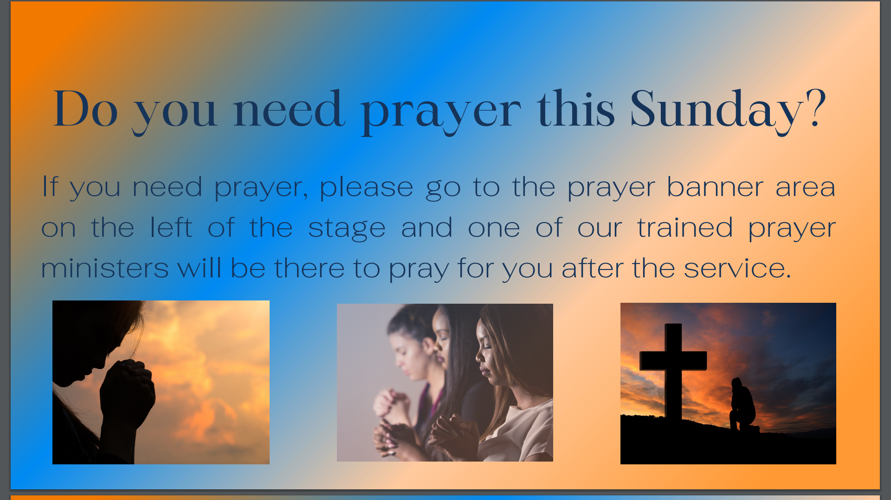

Slide 9


Slide 10
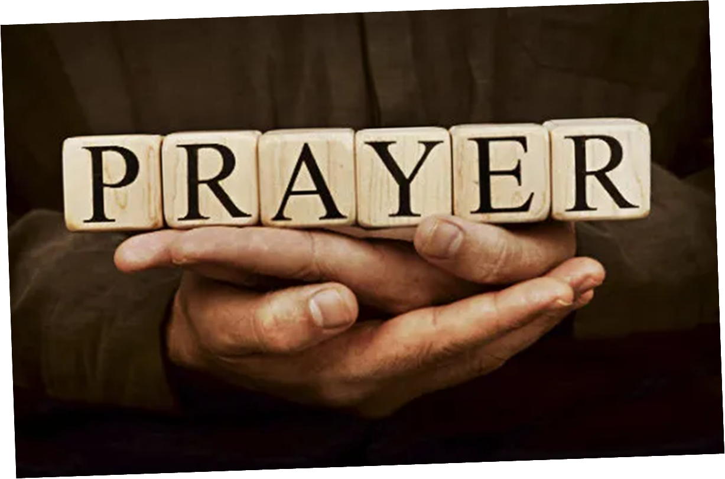

Slide 11


Slide 19


Slide 20
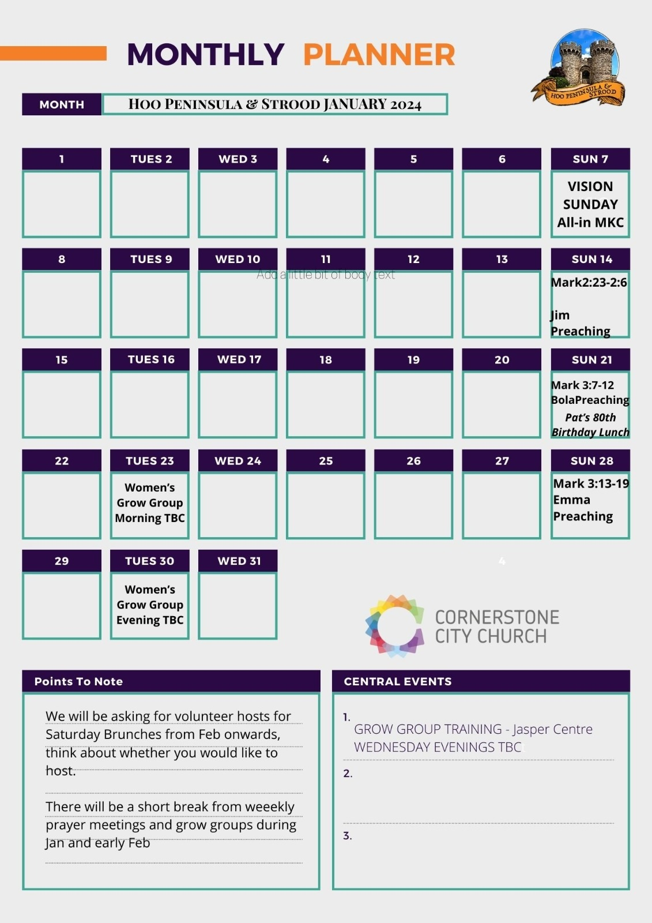

Slide 21


Slide 23
2 Corinthians 14 May the grace of the Lord Jesus Christ, and the love of God, and the fellowship of the Holy Spirit be with you all

